Slide 1
Introduction To Android Multimedia Architecture
Xiangbin Feng

Slide 2
Overview
Android Multimedia Architecture
Camera
Media Recoder
MediaPlayer

Slide 3
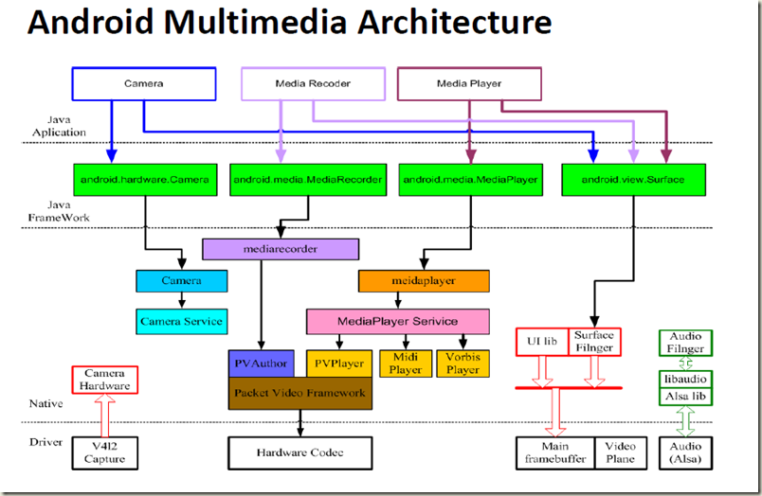
Android MultiMedia Architecture

Slide 4
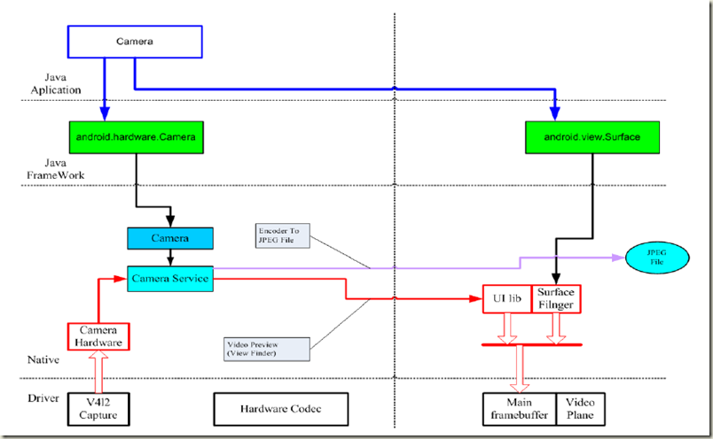
Camera

Slide 5
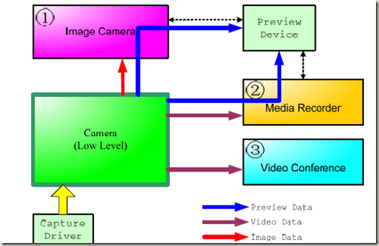
Camera--HAL

Slide 6
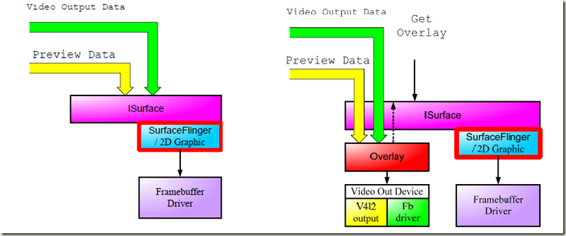
Camera--Video Overlay

Slide 7
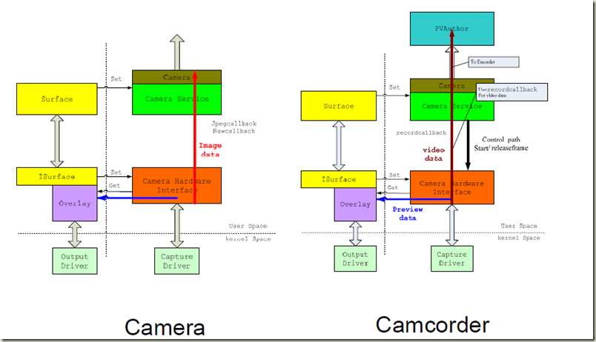
Camera & Camcorder

Slide 8
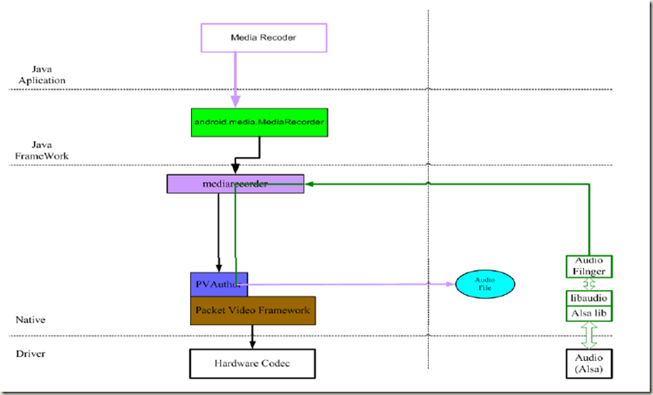
Media Audio Recoder

Slide 9
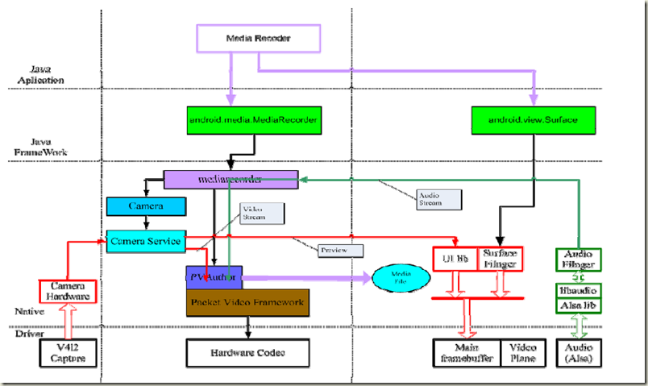
Media Video Recoder

Slide 10
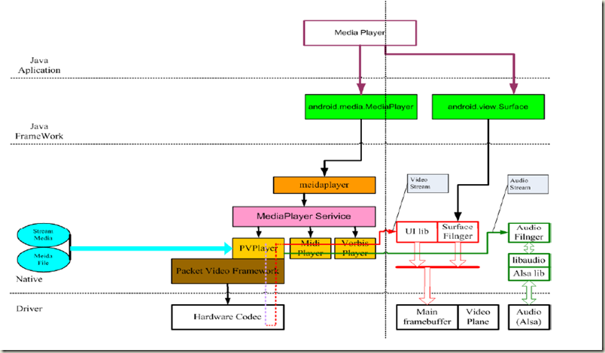
MediaPlayer

Slide 11
Thanks Q&A

